Slide 1



Code Trainer (3360707)
ENROLLMENT NO NAME OF STUDENT
1) 176620307029 PRATIK B. KANSARA
2) 176620307016 PRANAV P. CHANPARA
3) 176620307028 VANDIT D. JOSHI
4) 176620307031 RUTVIK M. KATHROTIYA
DEPARTMENT OF COMPUTER ENGINNERING
DARSHAN INSTITUTE OF ENGINEERING & TECHNOLOGY FOR DIPLOMA STUDIES
Guided By:
Prof. Payal M. Boda
Computer Engineering Dept.,
Darshan Institute of Engg. & Tech. for Diploma Studies, Rajkot

Slide 2
1. ABSTRACT
In present scenario usage of technology is widely increased mainly usage of internet had reached to every home. For eg. if you have to compile java program then we need JDK(Java Devlopment Kit) installed in your system. It is time taking process. But if you use our website no need to install JDK to your system. Our website allows you to compile source code and execute it online in different languages. Our website will provide online debugging and also allow to run the code in threee different languages. Users need to write code in editor and press "Run" button to compile and execute it. User also solve problem to increase logic by clicking problem solving.

Slide 3
2. PROBLEM SUMMARY
2.1 Problem Identification
If a user has to run and execute the source code of the program, he has to install all the necessary software in the system they will consume more required space in the device. And this is time taking process. Use can not do coding of different languages using one software
2.2 Problem Solution
By using our website the space required to install software will be reduced on your device. And user can perform coding of different programming languages like c,c++ and java at the same place..

Slide 4
3. Detail Description
Admin
The Admin can register and add task and its various input and output. Admin can also
See user that register to website.
a_ID: Id of Admin
admin_name: Name of admin
admin_pass: Password of admin

Slide 5
Tasks
The various tasks added by admin are store here.Admin can add , delete , update tasks as per needed.
t_ID: ID of task
t_name: Name of task
t_description: Description of task
t_noOfTestcase:How many testcase to be added
t_noOfInput: How many input in one testcase
t_noOfOutput: How many output in one testcase
ct_language: Language of task

Slide 6
InputOutput-
Various input and output added by admin are stored here. It contain inputs and appropriate output.
io_ID: Id of io
input: For input
output: For output
t_ID: Id of task

Slide 7
Users
The all details of user are stored here like id,username,password,etc.Admin can see user last login , user is active as well as user name.Admin can delete user if needed.
u_ID: Id of user
user_name: Name of user
user_pass: Password of user
user_email: Email of user
user_last_login: User last login
user_joined: user Joined date
is_active: activation of user inform of (0) for deactivate and (1) for activate

Slide 8
Completed Tasks
It stores task completed by user. If user satisfy testcase entered by admin then task is completed and stored. Admin can see Completed tasks done by user.
ID: Id of Completed tasks
u_ID: Id of user
t_ID: Id of task

Slide 9
3. DATA DICTONARY

Slide 10
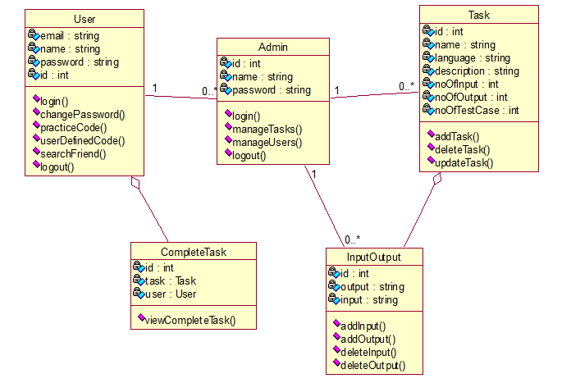
3. DIAGRAMS
3.1 Class Diagram

Slide 11
3.2 Sequence Diagram

Slide 12
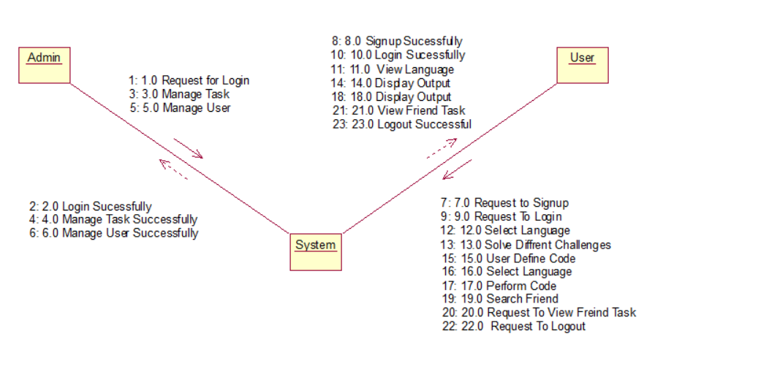
3.3 Collaboration Diagram

Slide 13
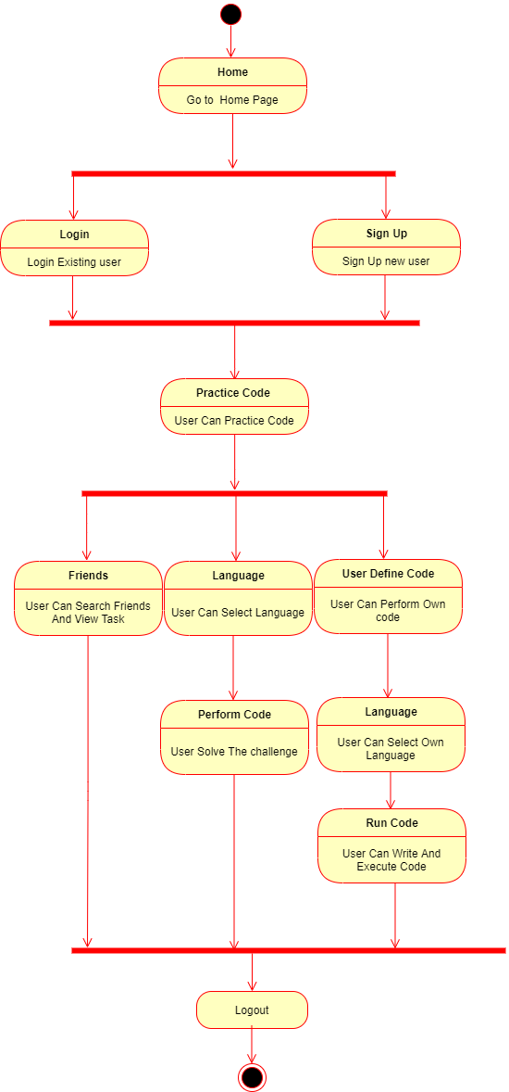
3.4 State Diagram

Slide 14
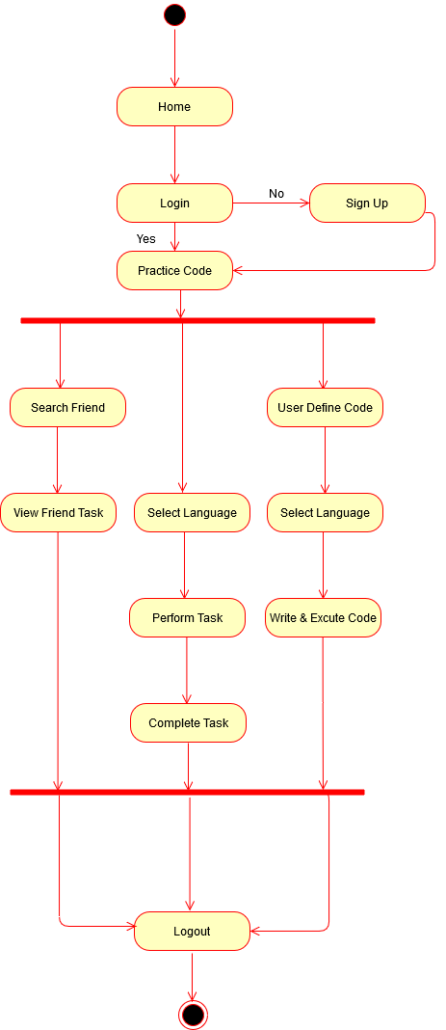
3.5 Activity Diagram

Slide 15
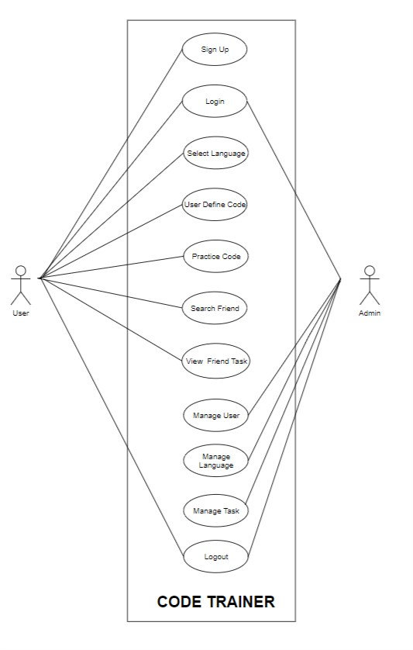
3.6 Use Case Diagram

Slide 16
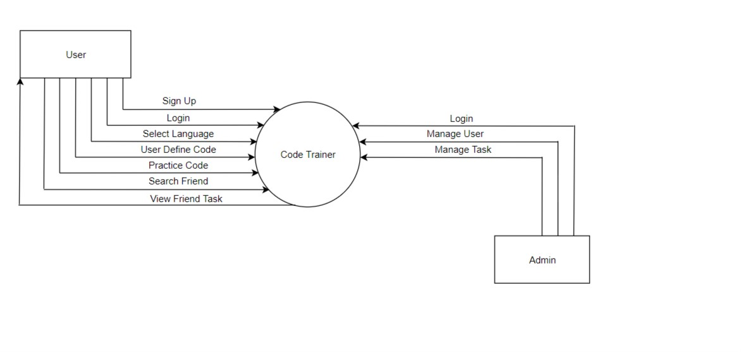
3.7.1 Data Flow Diagram for Admin(Level 1)

Slide 17
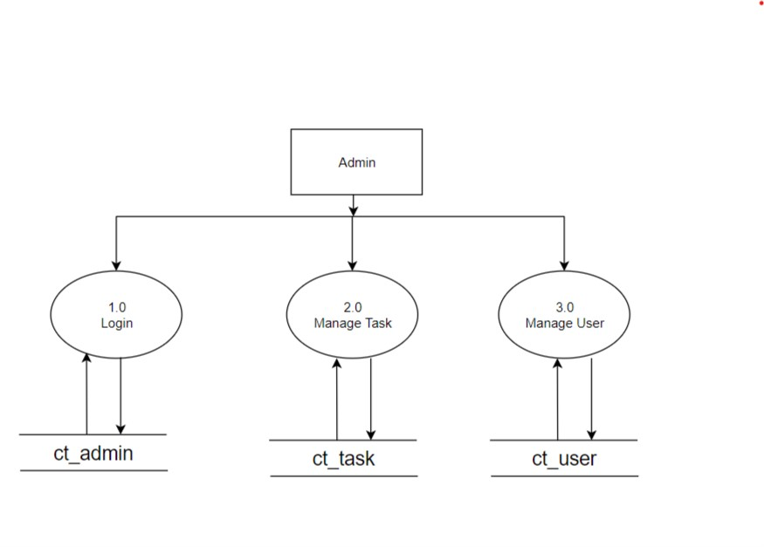
3.7.3 Data Flow Diagram - Admin(Level 1)

Slide 18
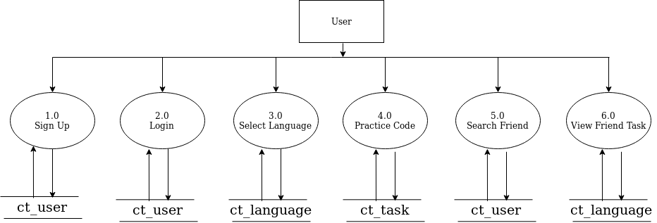
3.7.3 Data Flow Diagram for User(Level 1)

Slide 19
4. DATA DICTIONARY
4.1 Database Tables
ct_user
Field name | Data type | Size | Constraint | Reference | Description
u_ID | int | 20 | Primary Key | - | To get user Id
user_name | varchar | 60 | NOT NULL | - | To get user name
user_pass | varchar | 255 | NOT NULL | - | To get user password
user_email | varchar | 100 | NOT NULL | - | To get user email
user_last_login | datetime | - | NOT NULL | - | Time to get user lastlogin
user_Joined | datetime | - | NOT NULL | - | User joined time
Is_active | boolean | - | NOT NULL | - | For user activation check

Slide 20
ct_admin
Field Name | Data type | Size | Constraint | Reference | Description
a_ID | int | 20 | Primary key | - | For admin id
admin_name | varchar | 100 | NOT NULL | - | For admin name
Admin_pass | varchar | 100 | NOT NULL | - | For admin password
ct_tasks
Field Name | Data Type | Size | Constraint | Reference | Description
t_ID | int | 20 | Primary Key | - | Tssk Id
t_name | Varchar | 100 | NOT NULL | - | Taskname
t_description | Varchar | 100 | NOT NULL | - | Task description

Slide 21
ct_io
Field Name | Data type | Size | Constraint | Reference | Description
io_ID | int | 20 | Primary Key | - | Contain comment ID
input | Varchar | 500 | NOT NULL |  | For input
output | Varchar | 500 | NOT NULL | - | For output
t_ID | int | 50 | NOT NULL | - | For taskId
ct_completedtasks
Field Name | Data Type | Size | Constraint | Reference | Description
ID | int | 20 | Primary Key | - | For completed task id
u_ID | int | 20 | NOT NULL | - | For user id
t_ID | int | 20 | NOT NULL | - | For task id

Slide 22
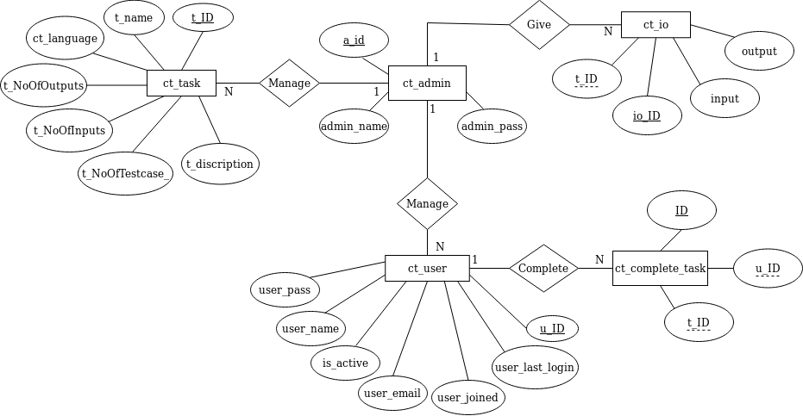
4.2 ER Diagram

Slide 23
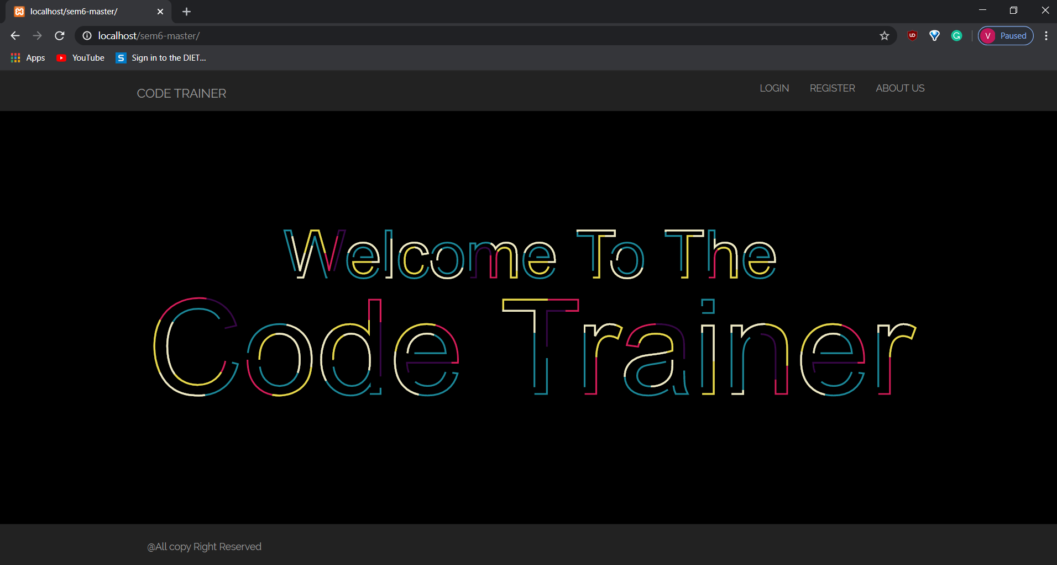
5. SCREENSHOTS
5.1 Welcome Page
It is an welcome page of website.
It appears before the starting of website.

Slide 24
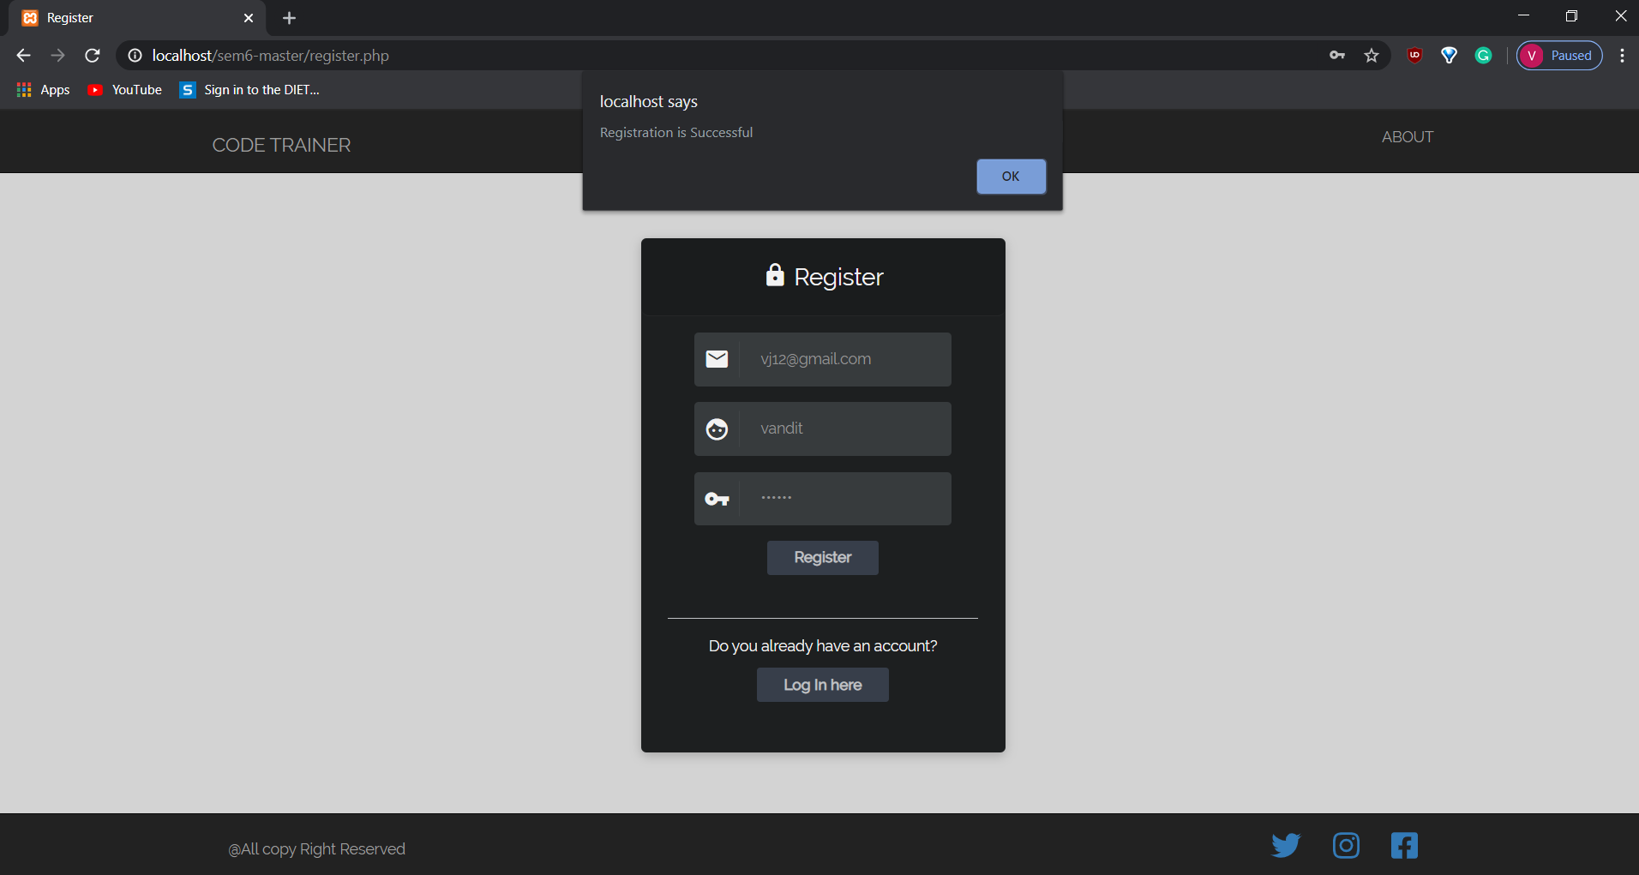
5.2 Register Page
This page displays the register process.
New users have to register their details in this page.
User can register by filling above details.

Slide 25
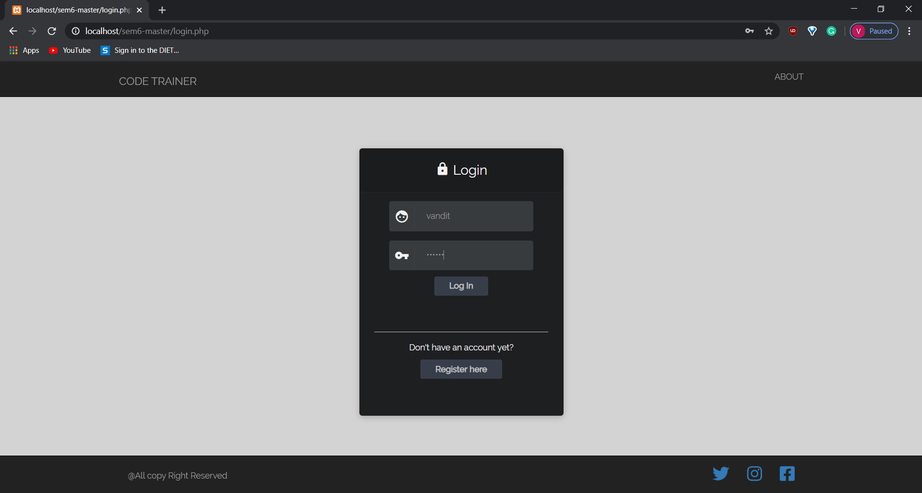
5.3 Login Page
This page displays the login process.
User has to login their account in this page for performing further operation.

Slide 26
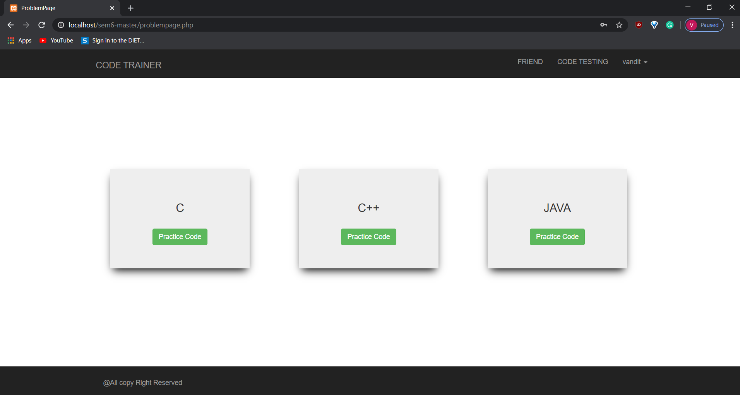
5.4 Home Page
This page displays the three different programming languages.
User has to select any one for performing further programming tasks.

Slide 27
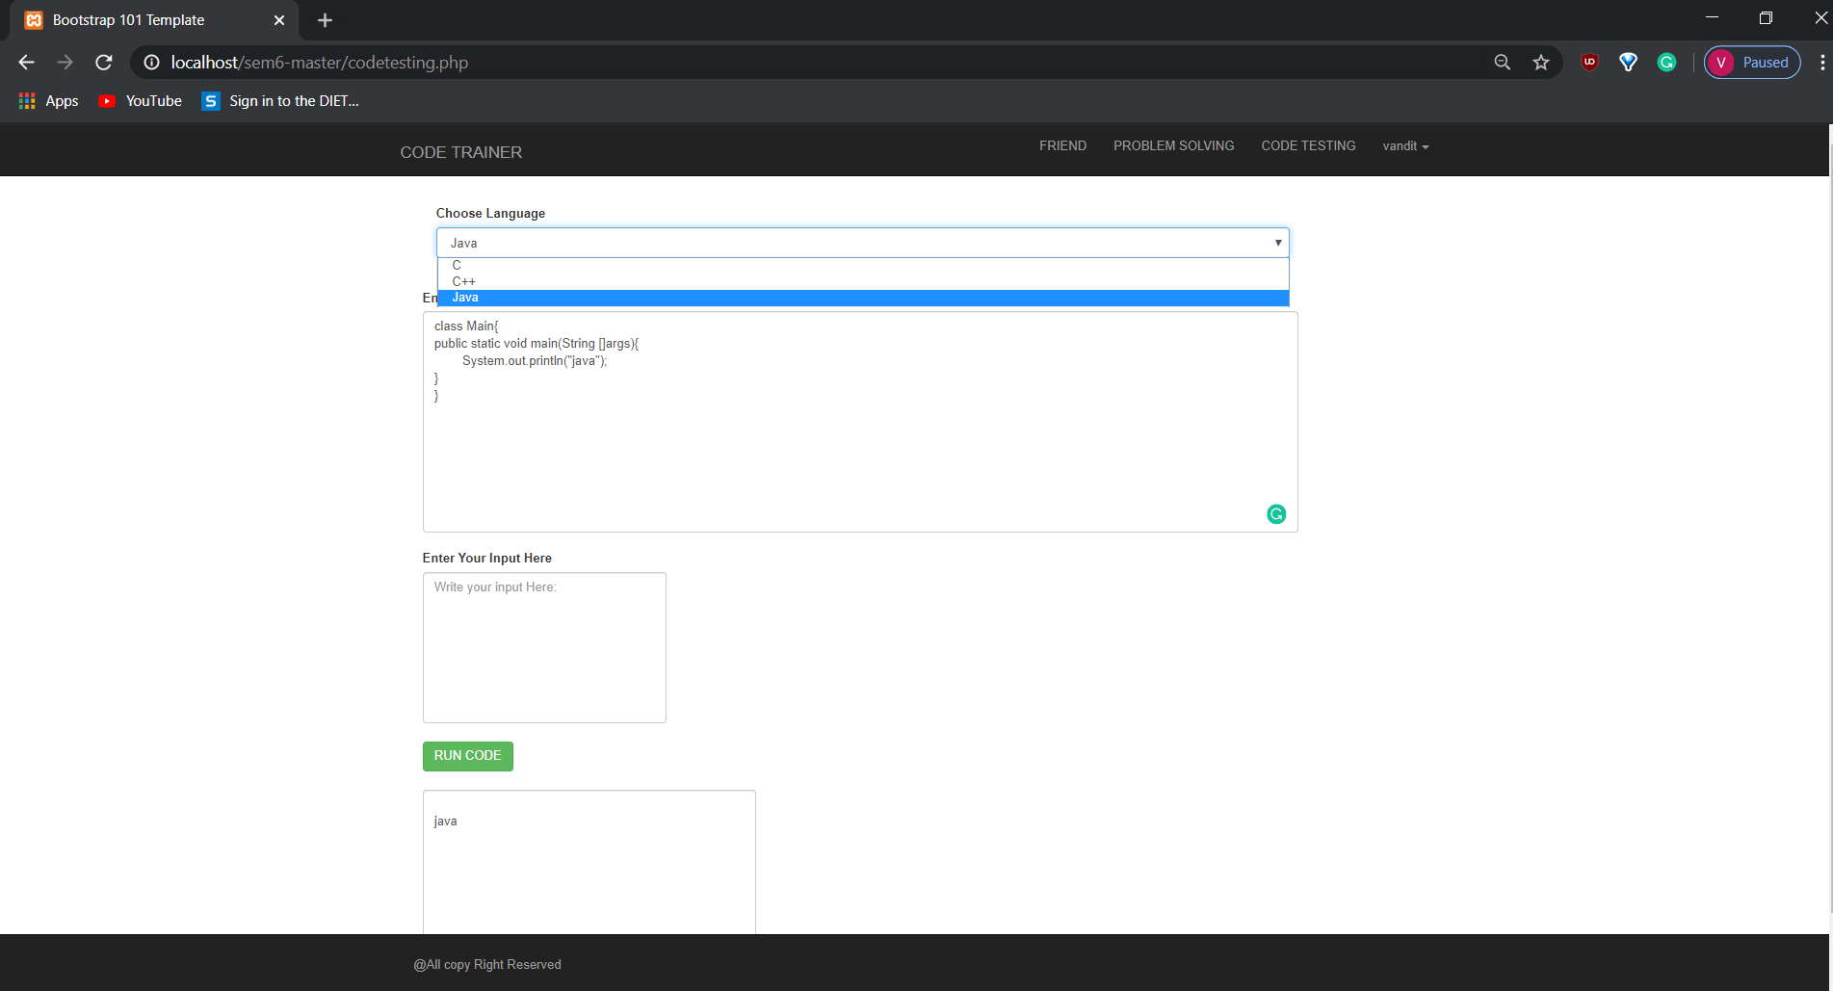
5.5 Code Testing Page
In this page user has to write code by selecting any one programming language from given options.
After the code is performed user has to run it by clicking on given green button.
The output of program will be displayed after clicking on green run code button.

Slide 28
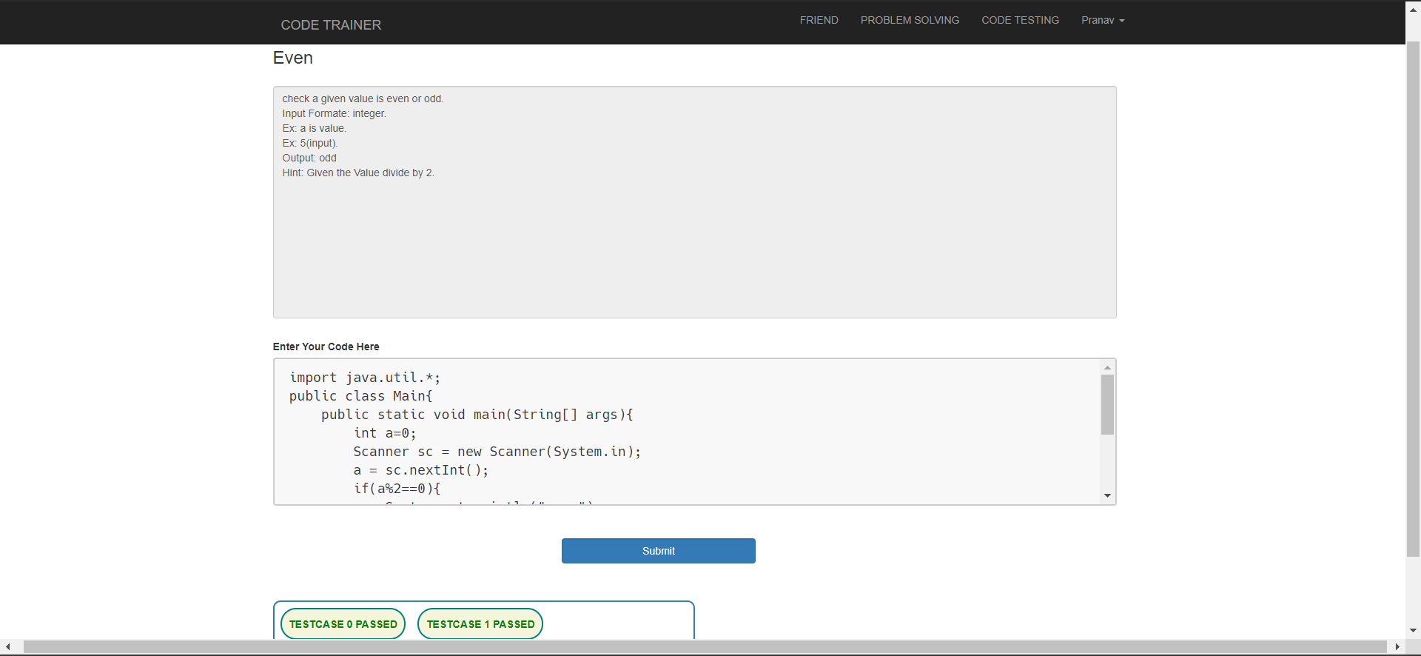
5.6 Problem Solving Page
Problem solving page displays about solving the errors in program performed.
User can improve their logic level in this page.

Slide 29
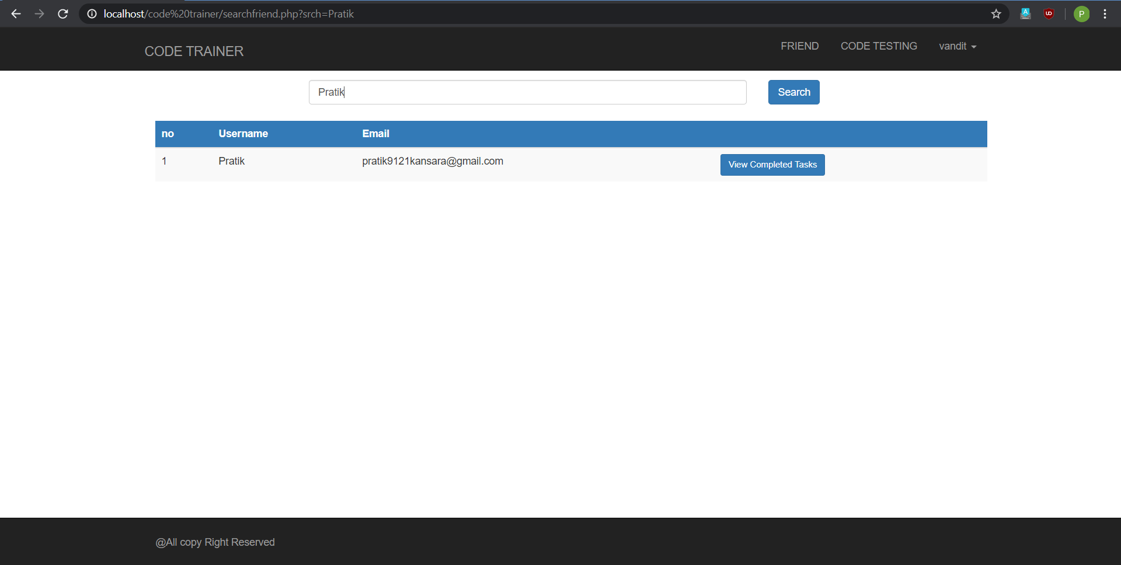
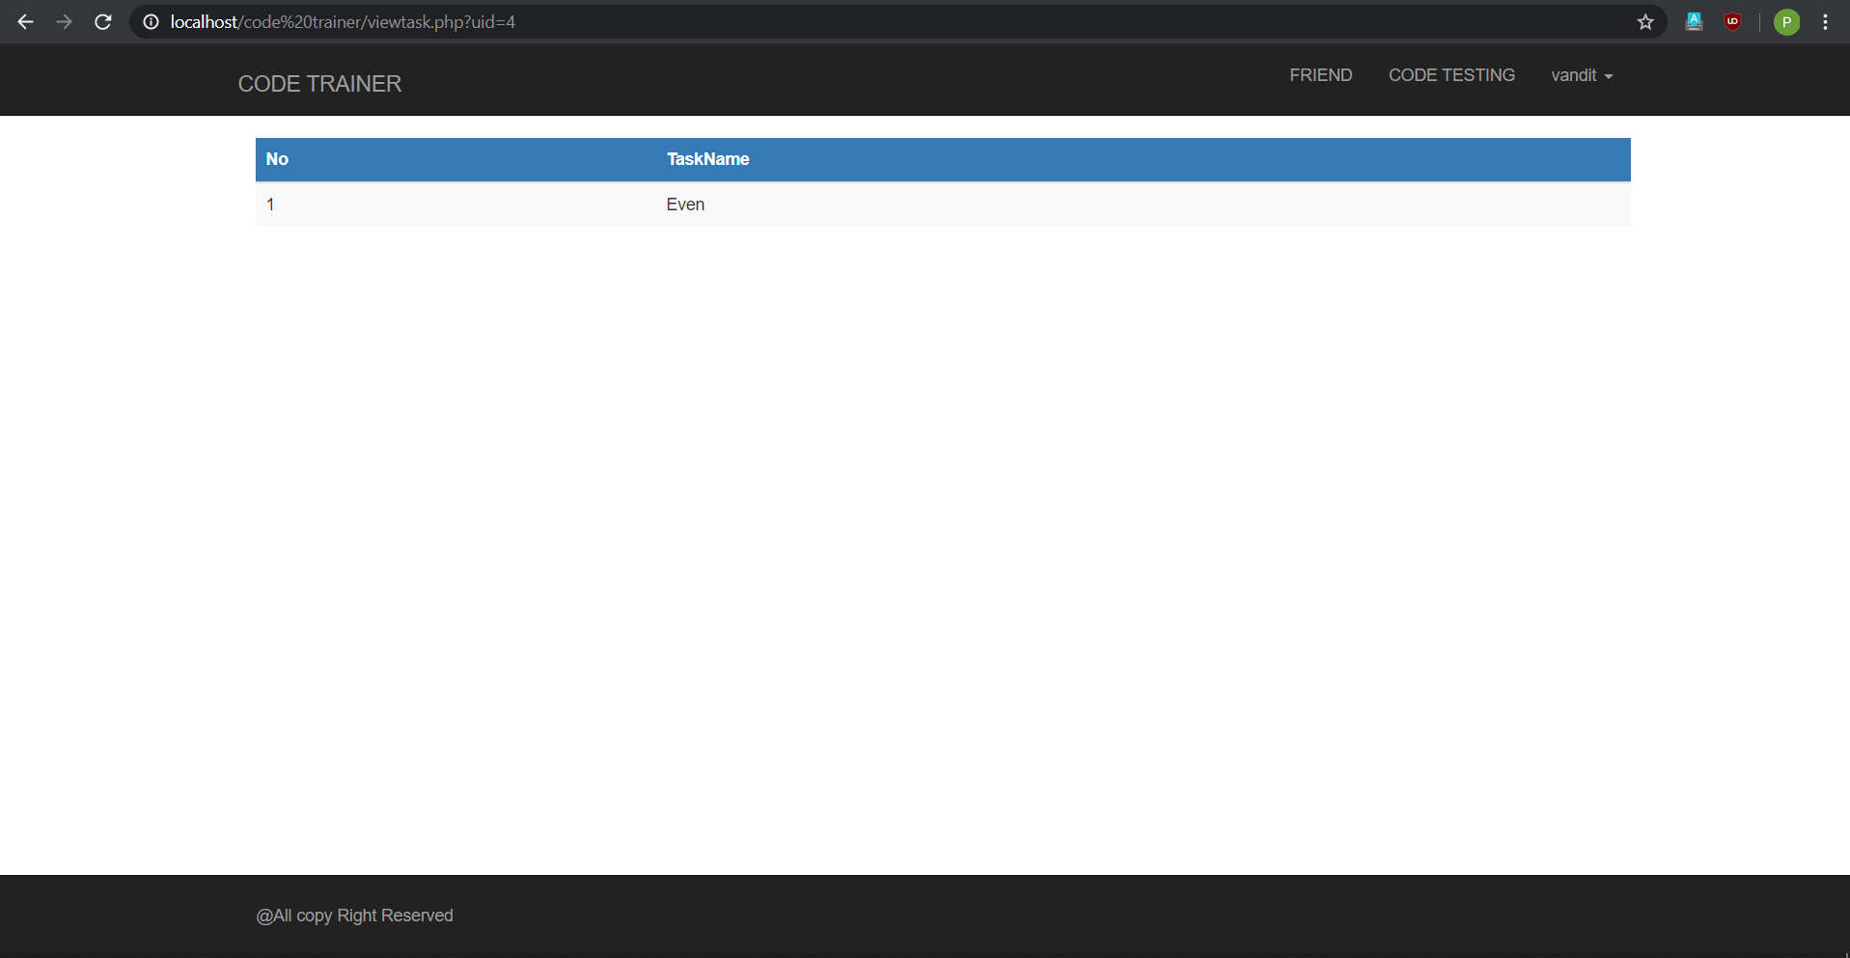
5.7 Search Friend
Fig 1.1 Fig 1.2
This is admin page for products.
Admin can manage products from here.
Admin can add, update and delete products from this page.

Slide 30
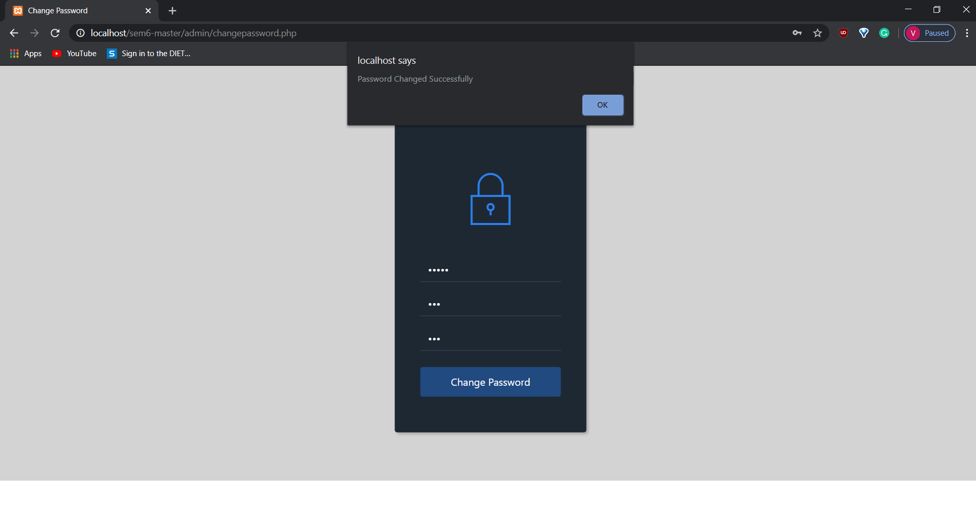
5.8 Change Password for Client
User can make changes in password in this page.
It appears when user forgets its own password.

Slide 31
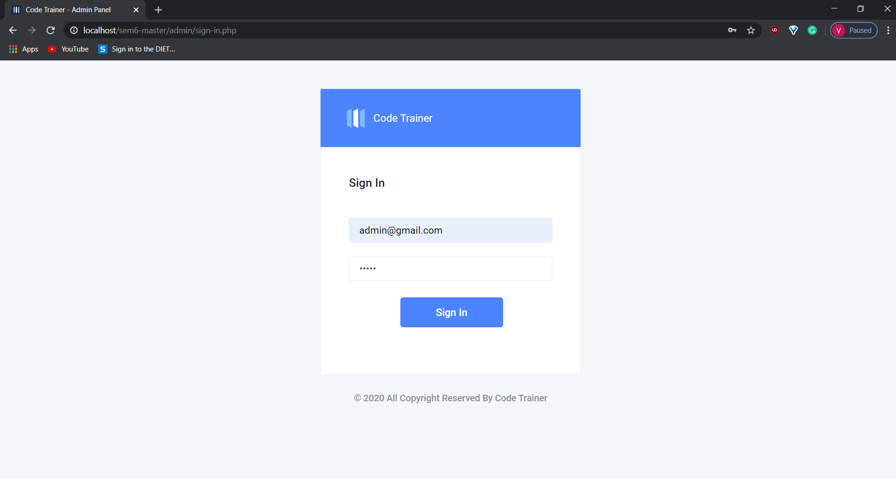
5.9 Sign Up Page for Admin
In this page admin has to fill all the details given.
Admin account will be created.

Slide 32
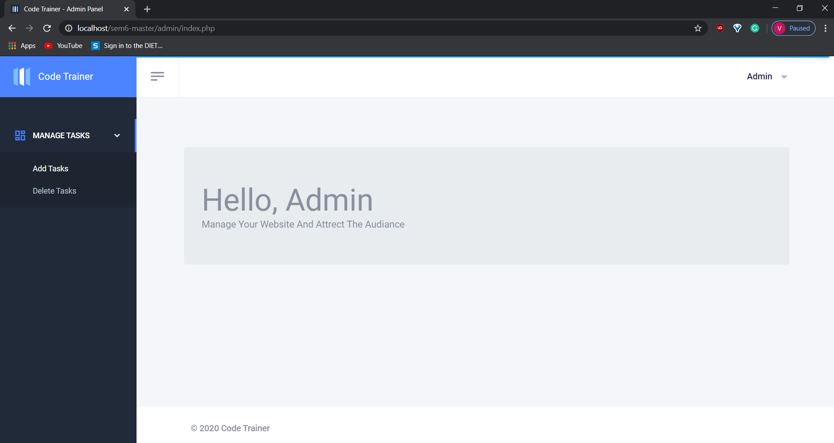
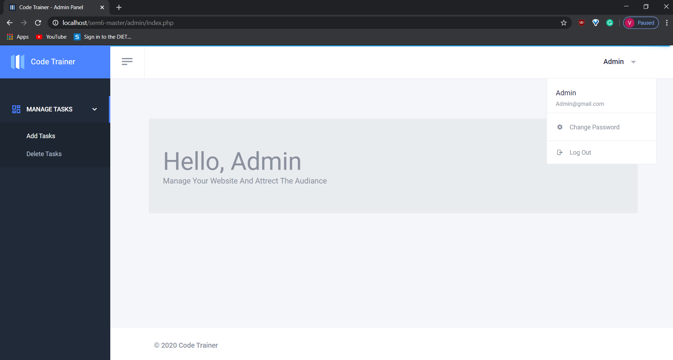
5.10 Admin Page
Fig 1.1 Fig 1.2
This is admin page.
Admin can manage tasks from here.
Admin can add, update and delete tasks from this page.

Slide 33
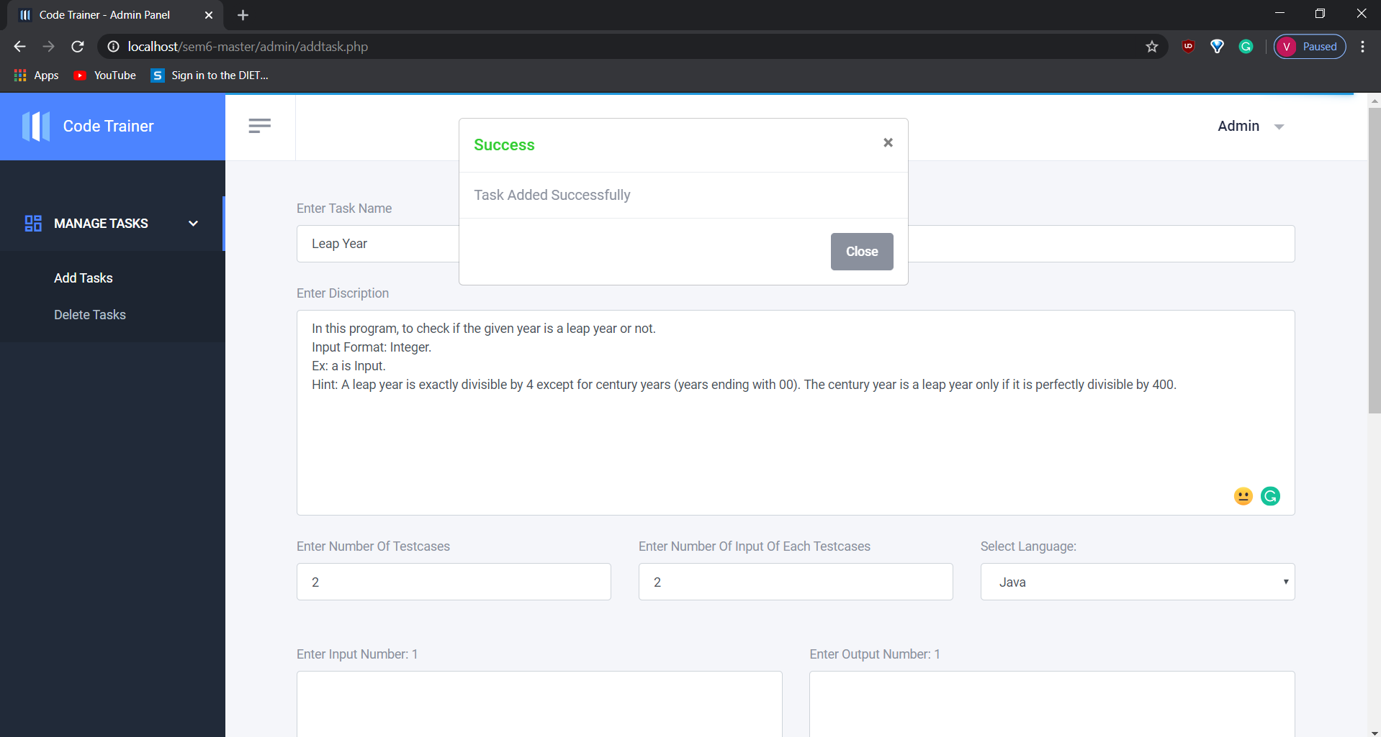
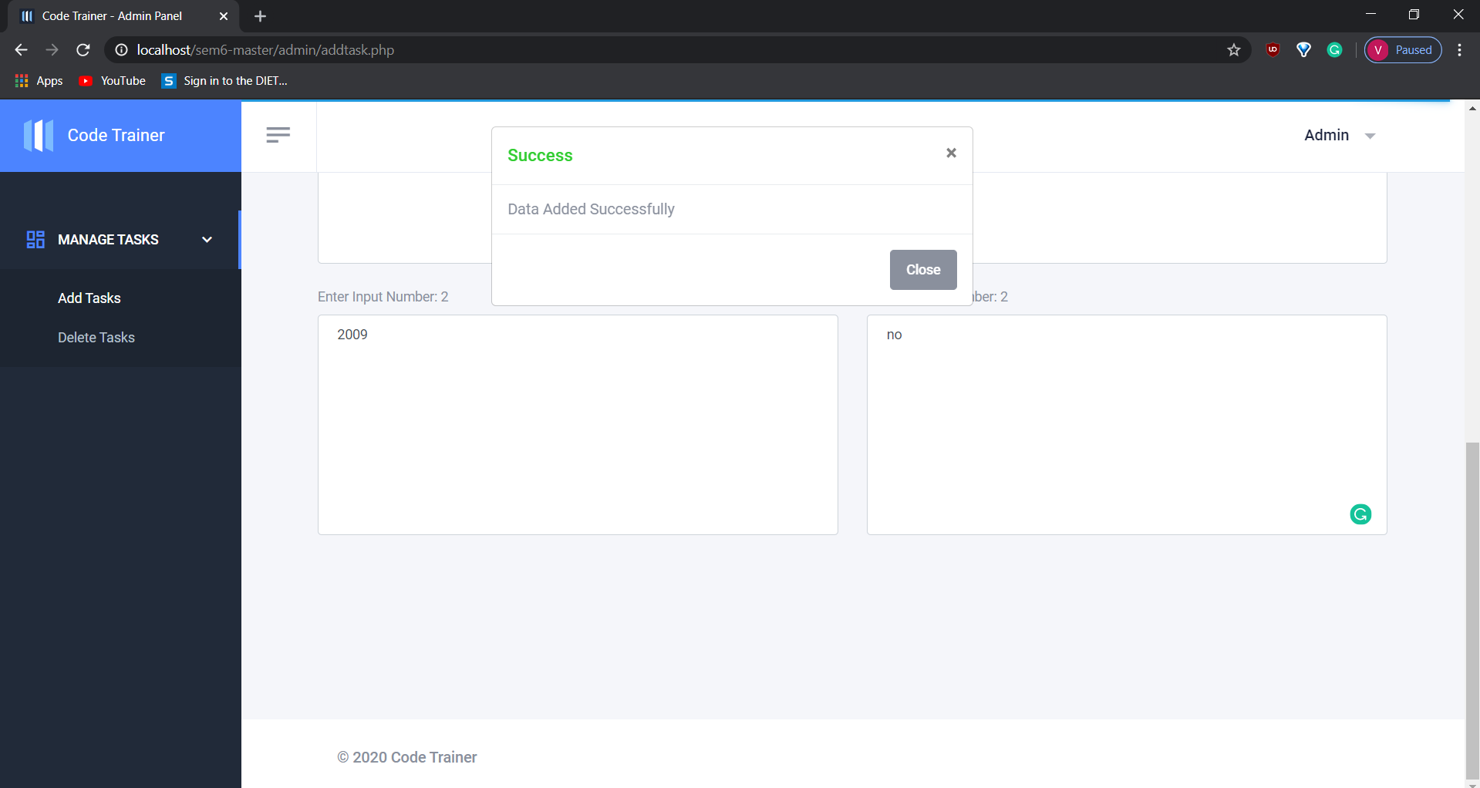
5.11 Manage Task Page
Fig 1.1 Fig 1.2
Fig 1.1 displays about adding tasks.
Fig 1.2 displays about adding the data of task given.

Slide 34
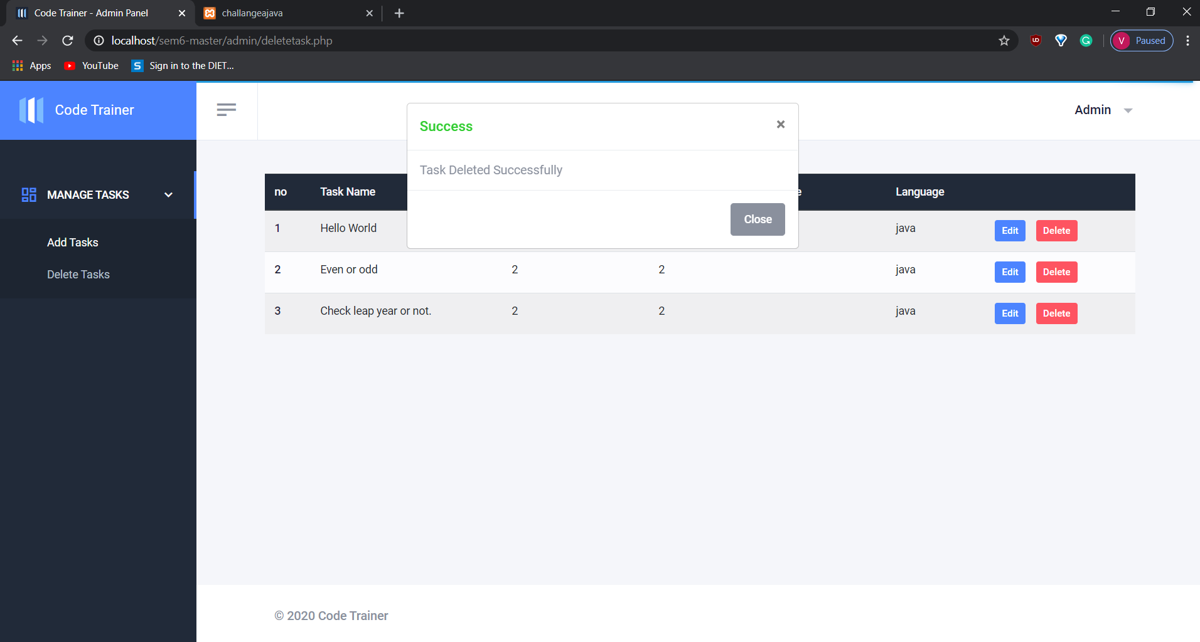
Fig 1.3
Fig 1.3 displays about deleting tasks.

Slide 35
5.12 Password Change Page for Admin
This page specifies to change the password in any condition.
If user forgets or has to create new password then this page is loaded.

Slide 36
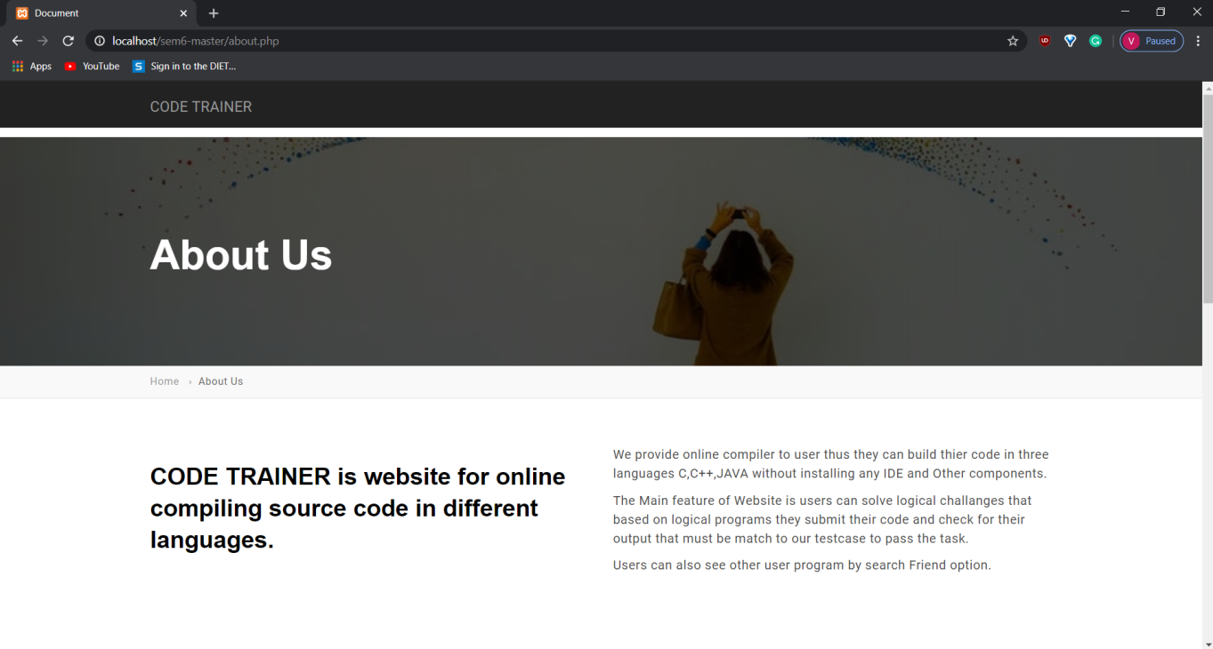
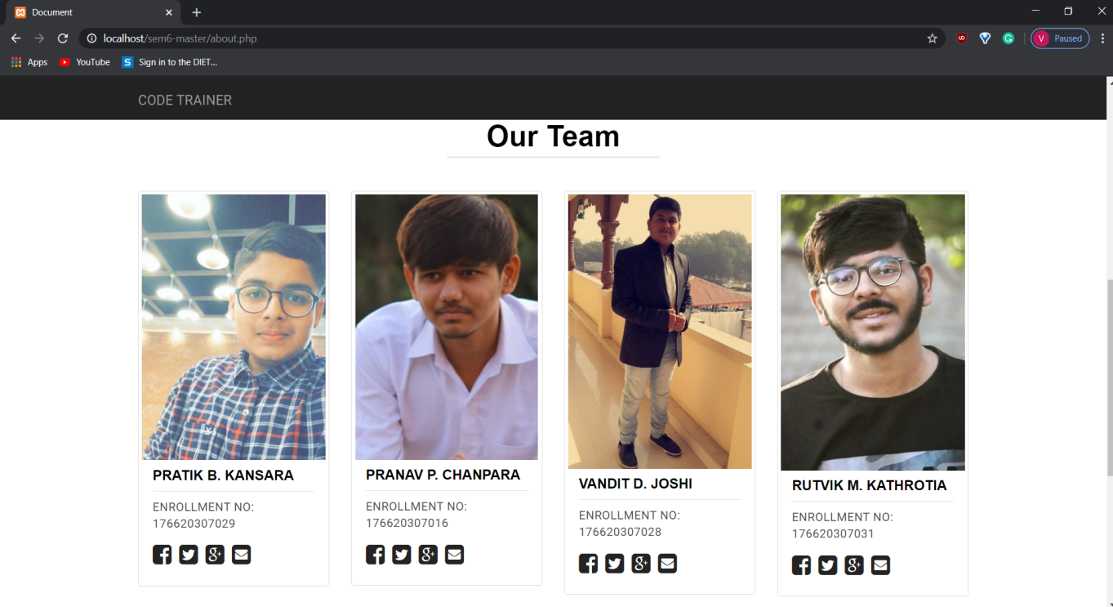
5.12 Contact page
Fig 1.1 Fig 1.2
Fig 1.1 displays the information about this website.
Fig 1.2 displays the information about the creators of this website.

Slide 37
6. Future Enhancement
We will add many more languages and make the editor more interactive. We will make interface of this website more and more user friendly .We are also thinking to add healthy competition of problem-solving that improves the logic of programmers.

Slide 38
8. EXPECTED OUTCOME
Users will be able to code on our website in different languages like java,c,c++ without installing any component. And user also practice of code and solve different challenges provided by admin.

Slide 39
THANK YOU AND ANY QUESTION?

